Slide 1
Check us out on the web:
womantowomanbiblestudy.com
Lecture Audios
PowerPoints
Notes
Facebook
@womantowomanbiblestudy
Notes:
1

Slide 2
Thank you for silencing electronic devices.

Slide 3
Introduction to Colossians

Slide 4
About Colossians:
One of Paul’s prison epistles (letters)
Written around A.D. 60-61 (the same year that the city was nearly destroyed by an earthquake)
Written to a church not founded by Paul
Churches at Colossae, Laodicea, & Hierapolis possibly founded by Epaphras, a disciple of Paul

Slide 5
Colossians 1:3, 5, 7-8
Paul says to the Colossians: we give thanks and pray for you (v.3)
“because of the hope laid up for you in heaven, of which you previously heard in the word of truth, the gospel . . .
just as you learned it from Epaphras, our beloved fellow bond-servant, who is a faithful servant of Christ on our behalf.
and he also informed us of your love in the Spirit.”

Slide 6
Colossians 4:12-13
Epaphras, who is one of your number, a bondslave of Jesus Christ, sends you his greetings, always laboring earnestly for you in his prayers, that you may stand perfect and fully assured in all the will of God.
For I testify for him that he has a deep concern for you and for those who are in Laodicea and Hierapolis.

Slide 7
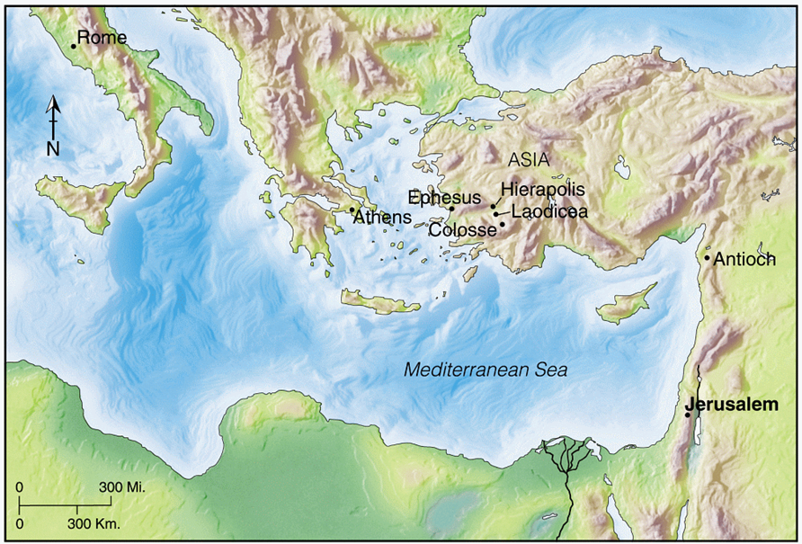
Notes:
From Tyndale Handbook of Bible Charts and Maps

Slide 8
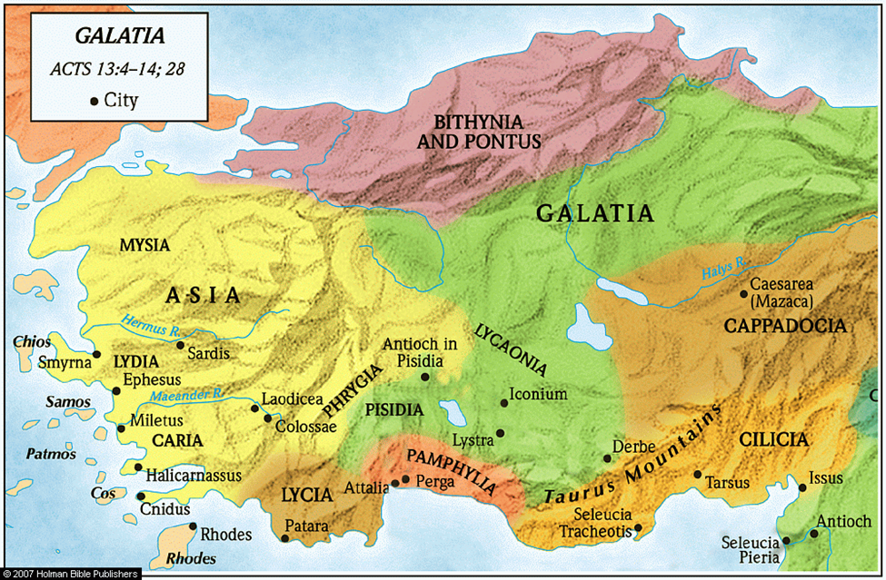
Notes:
From Holman Illustrated Study Bible Maps

Slide 9
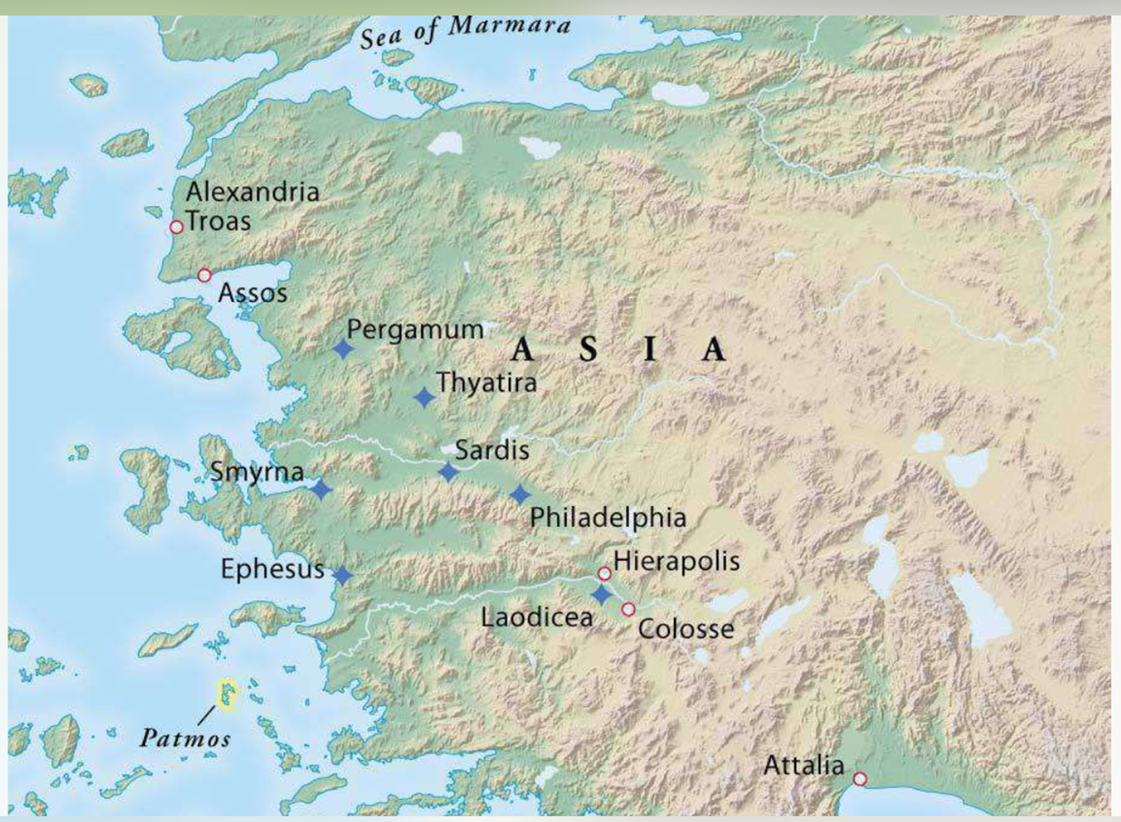
Notes:
From Zondervan Atlas of the Bible

Slide 10
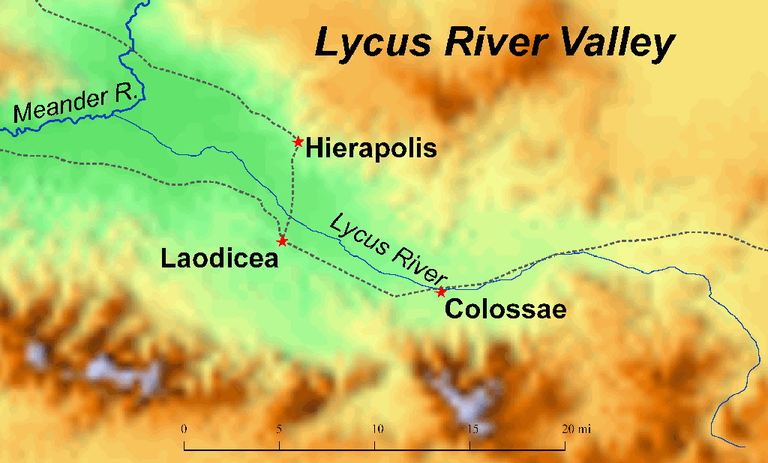
Notes:
Jenkins, Ferrell. “Hierapolis and the Lycus River Valley.” Ferrell’s Travel Blog, 17 Feb. 2009. ferrelljenkins.blog/2009/02/17/hierapolis-and-the-lycus-river-valley/. Accessed 9 Sept. 2019.

Slide 11
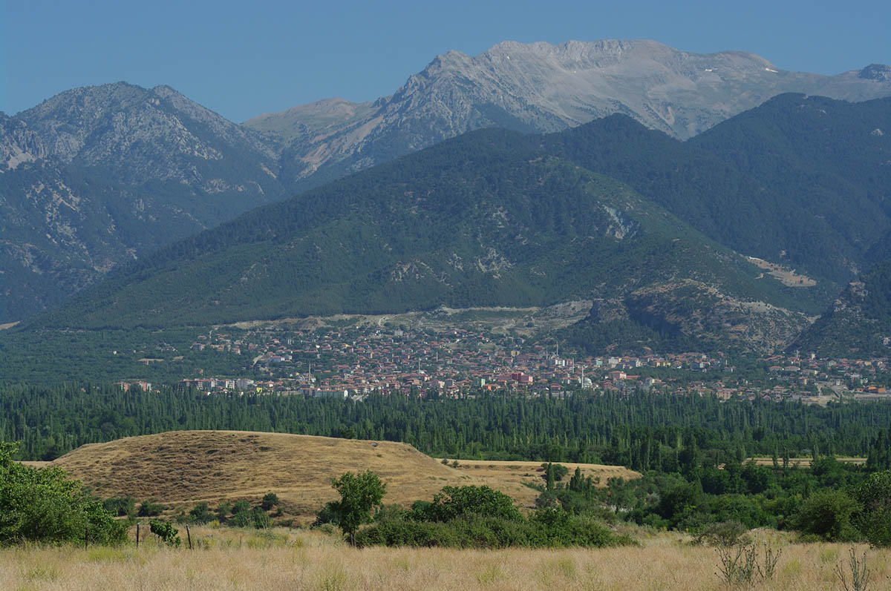
Colossae (unexcavated mound)
Notes:
Sauter, Megan. “Where Is Biblical Colossae?” Biblical Archaeology Society. 9 Apr. 2019. www.biblicalarchaeology.org/daily/biblical-sites-places/biblical-archaeology-sites/where-is-biblical-colossae/. Accessed 9 Sept. 2019.
[The unexcavated site of Colossae awaits exploration]

Slide 12
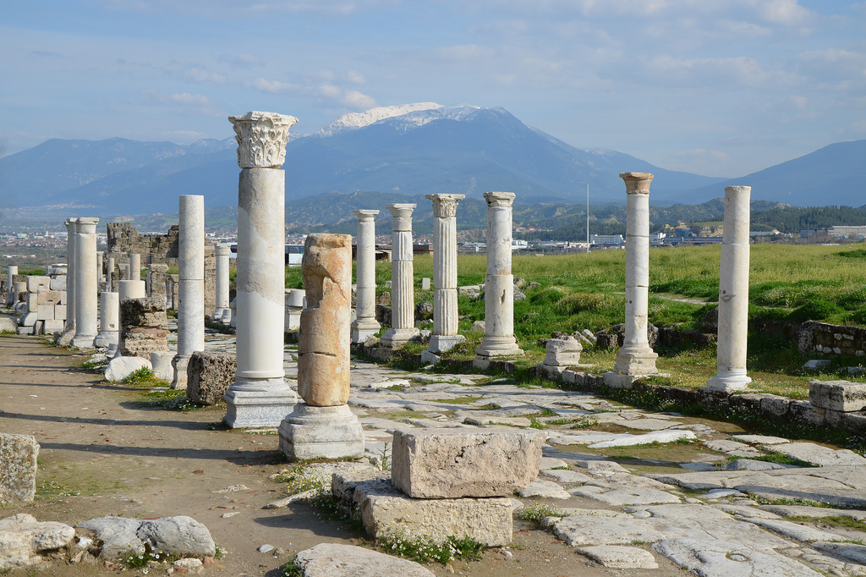
Main Street of Laodicea
Notes:
“Laodicea on the Lycus.” Following Hadrian Photography. January 5, 2017. followinghadrianphotography.com/2017/01/05/laodicea-on-the-lycus/. Accessed 9 Sept. 2019.

Slide 13
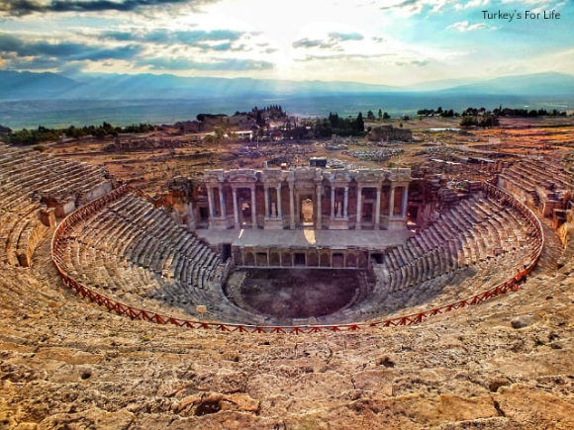
Theater at Hierapolis
Notes:
Hierapolis Of Phrygia – A Fascinating Ancient World Of Possibles And Maybes. Turkey’s for Life, www.turkeysforlife.com/2018/02/hierapolis-ruins-phrygia.html. Accessed 9 Sept. 2019.

Slide 14
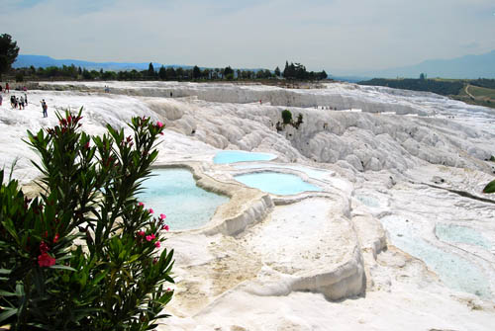
Limestone Formations, Hierapolis
Notes:
Jenkins, Ferrell. “Hierapolis and the Lycus River Valley.” Ferrell’s Travel Blog, 17 Feb. 2009. ferrelljenkins.blog/2009/02/17/hierapolis-and-the-lycus-river-valley/. Accessed 9 Sept. 2019.

Slide 15
Why did Paul write to the Colossians?
To express his personal interest in them & encourage them
To teach them how to grow spiritually
To correct false teaching

Slide 16
The False Teaching
Had a Jewish element (legalism, ritualism, holy days)
Had a pagan element (early form of Gnosticism)

Slide 17
Gnosticism (an early version)
Salvation through knowledge, not faith (Gk. Gnosis = knowledge)
Knowledge from mystical experience (not intellectual)
Occult knowledge (astrology, magic)
Esoteric knowledge (way to feel superior to others, available only to the initiated)

Slide 18
Gnosticism (an early version)
Belief that matter is evil & God would have nothing to do with it
Led to asceticism (mistreating the body) among some
Led to libertinism (only the soul is important; the body can do as it wishes) among others

Slide 19
Gnosticism (an early version)
Belief in intermediate beings (aeons or emanations, offshoots of deity) to be worshipped and appeased
A way to distance God from evil matter
Jesus is only one of these aeons.
Jesus is not literally both God and man (false doctrine).

Slide 20
GOD

AEON

AEON

AEON

CREATED THE WORLD

Slide 21
The False Teaching
Had a Jewish element (legalism, ritualism, holy days)
Had a pagan element (early form of Gnosticism)
Had a Christian element (It wore a Christian mask. “It did not deny Christ, but it did dethrone him.”)
~Curtis Vaughan, Expositor’s Bible Commentary

Slide 22
The True Teaching
Paul opposed falsehood with truth.
Jesus is “the image of the invisible God” (1:15).
He is the Creator (1:16).
He is the Redeemer (1:20).
In Him “are hidden all the treasures of wisdom and knowledge” (2:3).

Slide 23
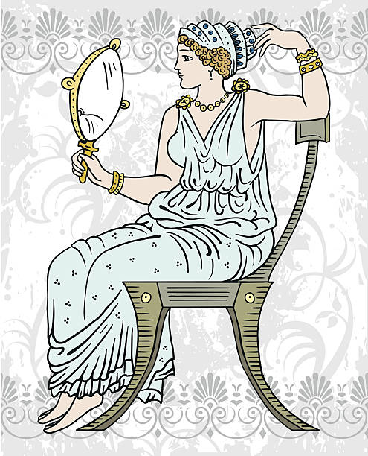
Reasons to Study Colossians
To know Jesus better
To grow spiritually
To be blessed

